Slide 1
Finite fields quick recap!

Slide 2
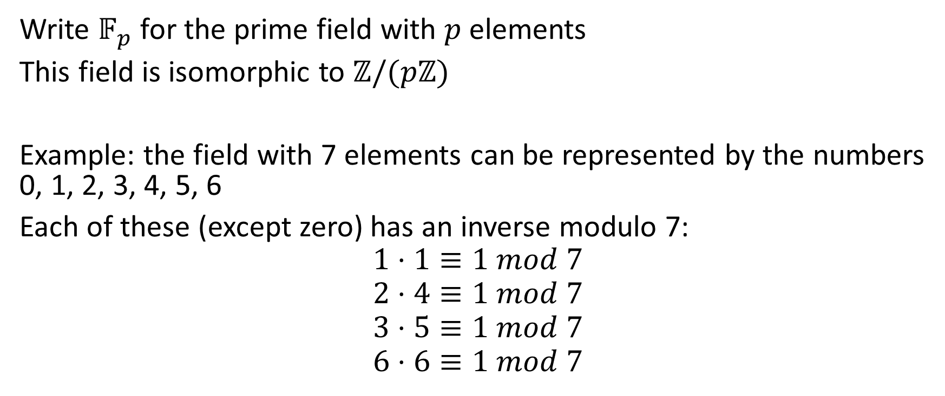

Prime fields are basically the integers modulo $N$
Write $𝔽_{p}$ for the prime field with $p$ elements
This field is isomorphic to $ℤ/(pℤ)$
Example: the field with 7 elements can be represented by the numbers 0, 1, 2, 3, 4, 5, 6
Each of these (except zero) has an inverse modulo 7:
$$1⋅1≡1 mod 7$$
$$2⋅4≡1 mod 7$$
$$3⋅5≡1 mod 7$$
$$6⋅6≡1 mod 7$$

Slide 3

Prime power finite fields are NOT isomorphic to integer rings!
$𝔽_{4}≠$ $\frac{ℤ}{4ℤ}$

Slide 4
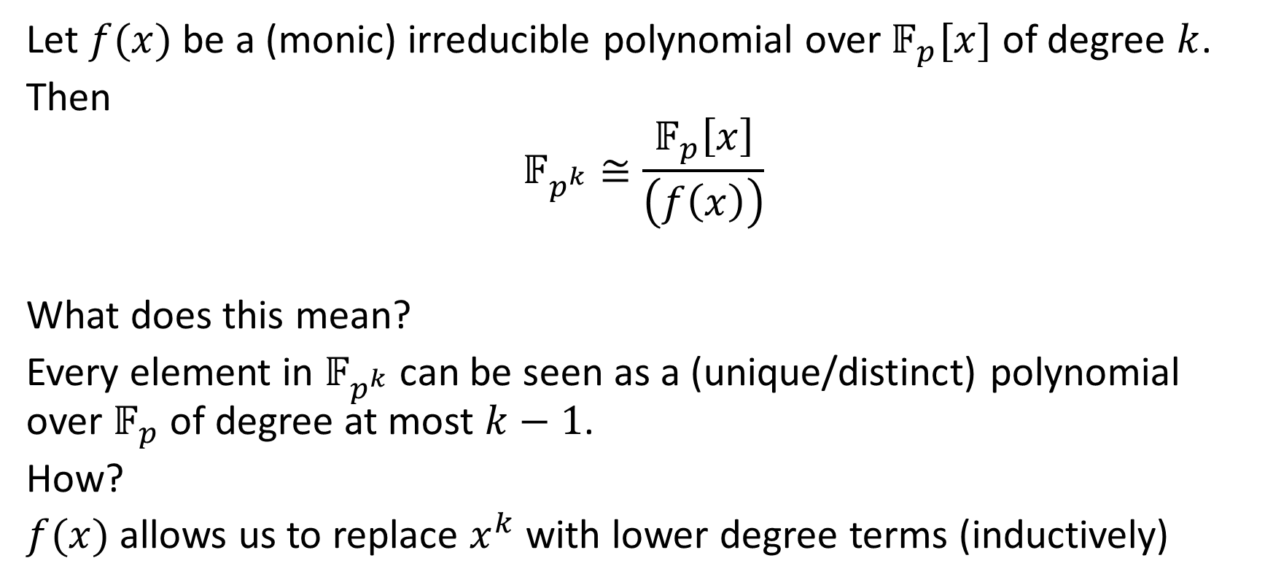

In order to create a field $𝔽_{p^{k}}$ we need to work over a field extension of $𝔽_{p}$
Let $f(x)$ be a (monic) irreducible polynomial over $𝔽_{p}[x]$ of degree $k$.
Then
$$𝔽_{p^{k}}≅\frac{𝔽_{p}\left[x\right]}{\left(f\left(x\right)\right)}$$
What does this mean?
Every element in $𝔽_{p^{k}}$ can be seen as a (unique/distinct) polynomial over $𝔽_{p}$ of degree at most $k−1$.
How?
$f(x)$ allows us to replace $x^{k}$ with lower degree terms (inductively)

Slide 5
Finding irreducible polynomials
Typically, prime fields have many distinct irreducible polynomials!
These polynomials result in fields that are all isomorphic, but differ in representation.
Useful Magma commands:
RandomIrreduciblePolynomial( )
IsIrreducible( )

Slide 6
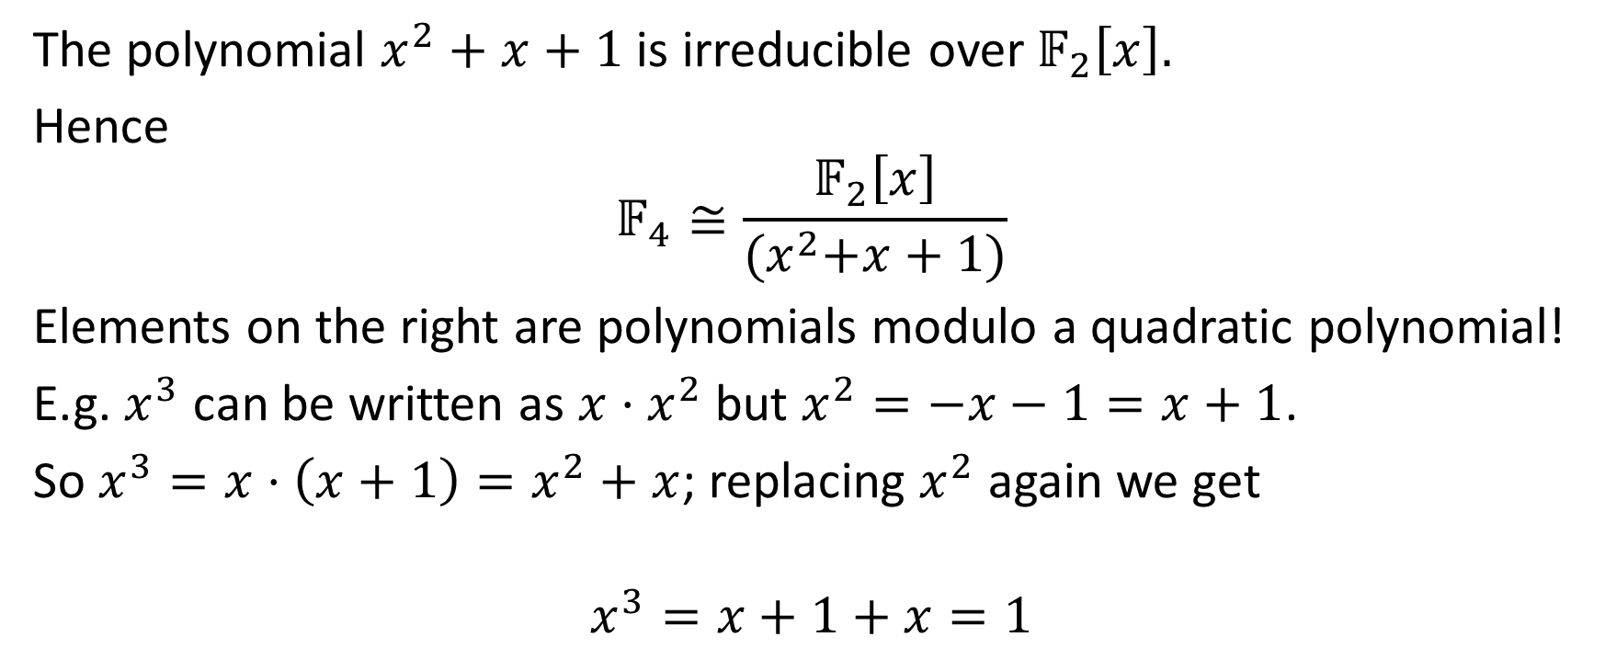
Example: The field with 4 elements
The polynomial $x^{2}+x+1$ is irreducible over $𝔽_{2}\left[x\right].$
Hence
$$𝔽_{4}≅\frac{𝔽_{2}\left[x\right]}{{(x}^{2}+x+1)}$$
Elements on the right are polynomials modulo a quadratic polynomial!
E.g. $x^{3}$ can be written as $x⋅x^{2}$ but $x^{2}=−x−1=x+1$.
So $x^{3}=x⋅\left(x+1\right)=x^{2}+x$; replacing $x^{2}$ again we get
$$x^{3}=x+1+x=1$$

Slide 7
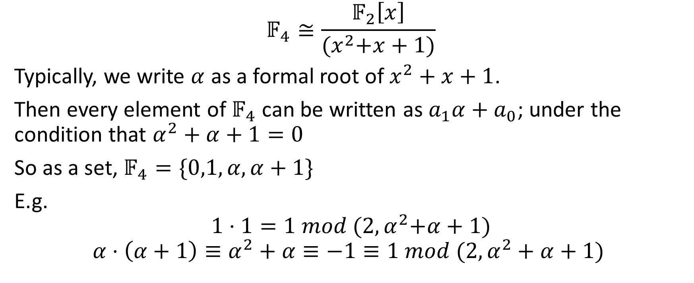
The field with 4 elements (ctd)
$$𝔽_{4}≅\frac{𝔽_{2}\left[x\right]}{{(x}^{2}+x+1)}$$
Typically, we write $α$ as a formal root of $x^{2}+x+1$.
Then every element of $𝔽_{4}$ can be written as $a_{1}α+a_{0}$; under the condition that $α^{2}+α+1=0$
So as a set, $𝔽_{4}=\{0,1,α, α+1\}$
E.g.
$$1⋅1=1 mod {(2,α}^{2}+α+1)$$
$$α⋅\left(α+1\right)≡α^{2}+α≡−1≡1 mod (2,α^{2}+α+1)$$

Slide 8
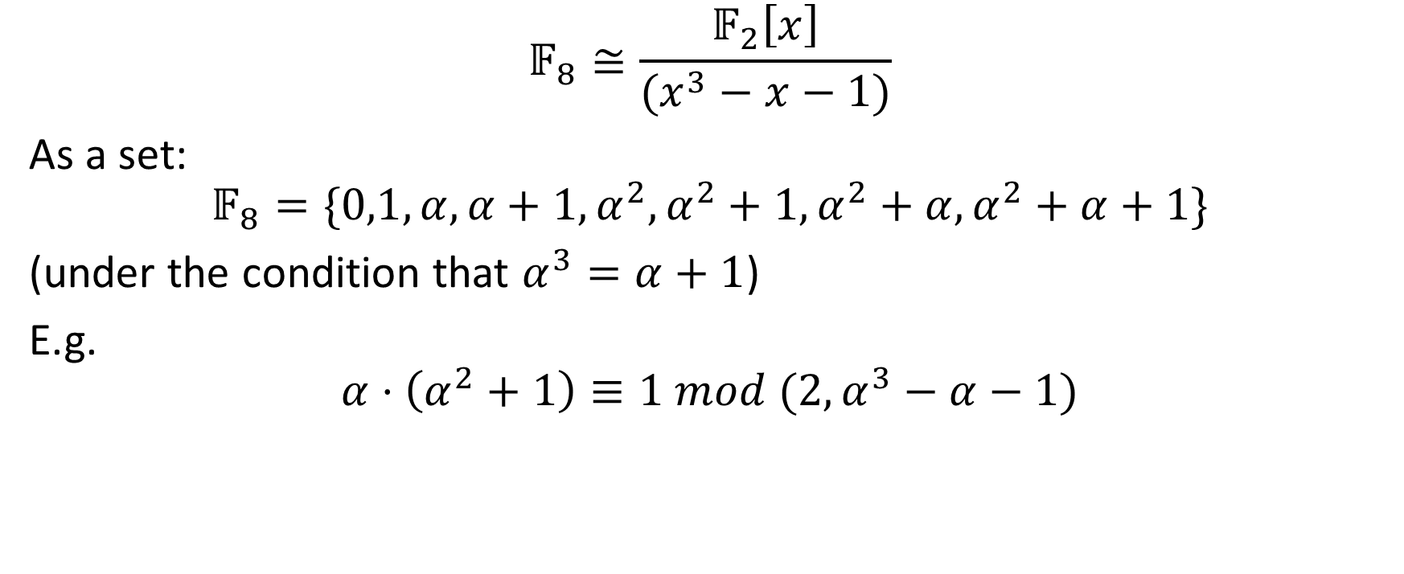
The field with 8 elements
$$𝔽_{8}≅\frac{𝔽_{2}\left[x\right]}{(x^{3}−x−1)}$$
As a set:
$$𝔽_{8}=\{0,1,α, α+1,α^{2},α^{2}+1, α^{2}+α, α^{2}+α+1\}$$
(under the condition that $α^{3}=α+1$)
E.g.
$$α⋅\left(α^{2}+1\right)≡1 mod (2,α^{3}−α−1)$$

Slide 9

The field with 9 elements
$$𝔽_{9}≅\frac{𝔽_{3}\left[x\right]}{{(x}^{2}+1)}$$
As a set:
$$𝔽_{9}=\{0,1,2,α, α+1,α+2,2α,2α+1,2α+2\}$$
(under the condition that $α^{2}=2$)
E.g.
$$(α+1)⋅\left(α+2\right)≡1 mod (2,α^{2}+1)$$

Slide 10
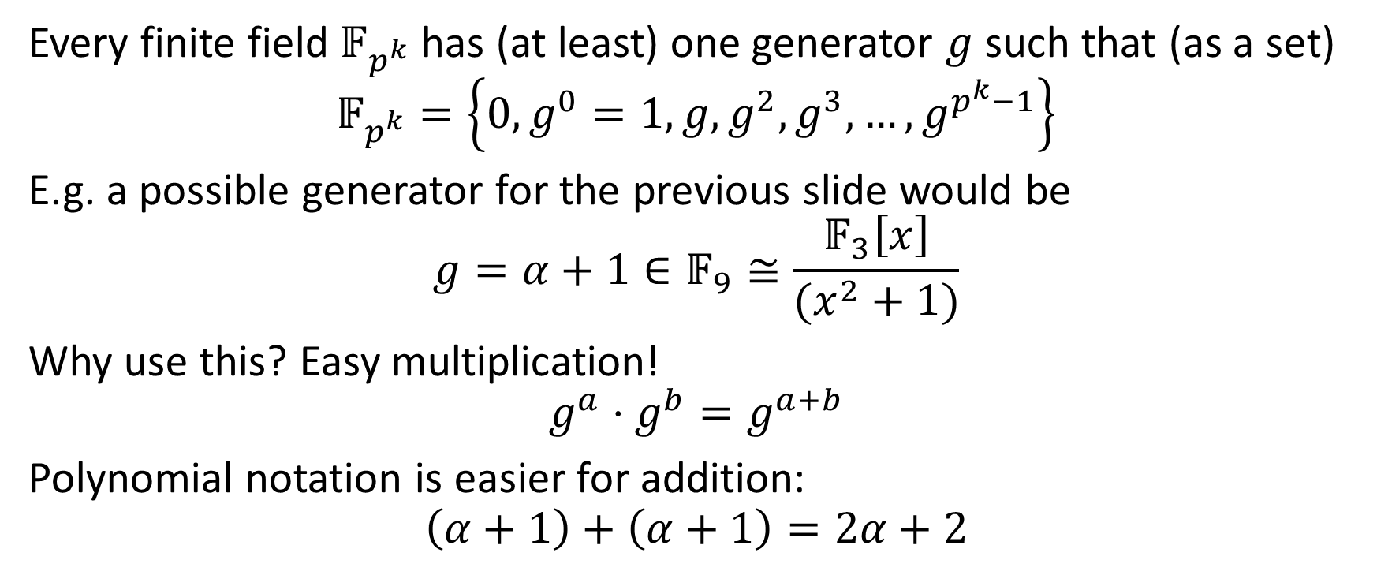
Polynomial representation versus power representation
Every finite field $𝔽_{p^{k}}$ has (at least) one generator $g$ such that (as a set)
$$𝔽_{p^{k}}=\left\{{0,g}^{0}=1, g, g^{2},g^{3},…, g^{p^{k}−1}\right\}$$
E.g. a possible generator for the previous slide would be
$$g=α+1∈𝔽_{9}≅\frac{𝔽_{3}\left[x\right]}{(x^{2}+1)}$$
Why use this? Easy multiplication!
$$g^{a}⋅g^{b}=g^{a+b}$$
Polynomial notation is easier for addition:
$$\left(α+1\right)+\left(α+1\right)=2α+2$$

